Slide 1




Web Development for Games
This presentation explores the world of web game development, covering the fundamentals and advanced concepts required to build engaging and interactive game experiences for the web.
by srushti Kotagi

Slide 2

Fundamentals of Web Technologies
1
HTML
2
CSS
HTML, or Hypertext Markup Language, serves as the foundation of web pages, defining the structure and content of a game.
CSS, or Cascading Style Sheets, controls the visual presentation of game elements, creating a captivating aesthetic.
3
JavaScript
4
Libraries & Frameworks
JavaScript powers the interactive elements, animations, and game logic, bringing the game to life.
Popular libraries and frameworks like Phaser, PixiJS, and Three.js simplify game development by providing pre-built components and functionalities.

Slide 3
Building Game User Interfaces
Layout & Navigation
Visual Design
Interaction & Feedback
Design a clear and intuitive user interface that allows players to easily navigate menus, interact with game elements, and access key information.
Create an aesthetically pleasing visual style that aligns with the game's theme and target audience, using captivating graphics and engaging animations.
Implement interactive elements like buttons, sliders, and input fields that provide responsive feedback to player actions.

Slide 4

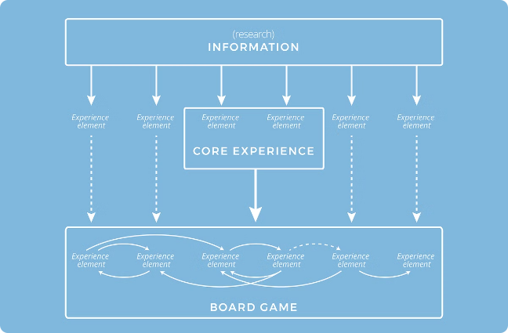
Integrating Game Logic with Web APIs
1
API Integration
Utilize Web APIs to access external data, services, and functionalities, like retrieving game assets, storing player data, or integrating with social platforms.
2
Event Handling
Implement event listeners to capture player input and trigger appropriate game logic, such as moving characters, firing projectiles, or updating the game state.
3
Data Management
Store and manage game data, including player progress, inventory items, and game settings, using local storage, databases, or cloud services.

Slide 5


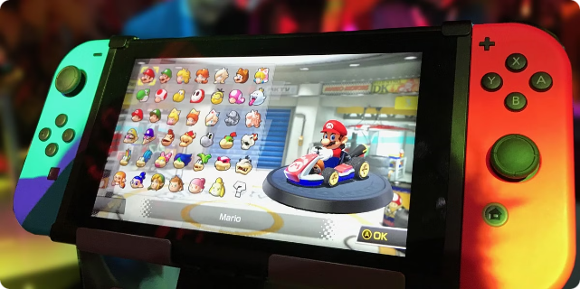


Networking and Multiplayer Functionality
WebSockets
Utilize WebSockets for real-time communication between clients and servers, enabling seamless multiplayer interaction.
Multiplayer Architecture
Choose a suitable multiplayer architecture, such as client-server or peer-to-peer, based on the game's requirements and scalability.
Synchronization
Ensure smooth synchronization of game state across all players to prevent lag and maintain a consistent gameplay experience.

Slide 6

Performance Optimization for Web Games
Resource Optimization
Minimize file sizes of images, audio, and other game assets to reduce loading times.
Code Optimization
Use efficient algorithms, minimize unnecessary calculations, and optimize code for performance.
Caching
Leverage browser caching to store frequently used game assets, reducing server requests and improving load times.

Slide 7

Deployment and Hosting Considerations
Hosting Platforms
Content Delivery Networks (CDNs)
Security Measures
Choose a reliable hosting provider that offers the necessary resources and infrastructure for your game, considering traffic, performance, and security.
Utilize CDNs to distribute game assets across multiple locations, reducing latency and improving loading times for players worldwide.
Implement security measures to protect your game from unauthorized access, data breaches, and malicious attacks.

Slide 8


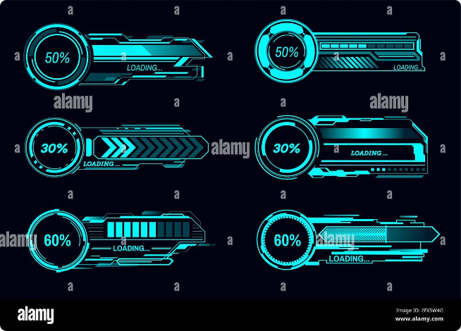


Conclusion and Future Trends
Emerging Technologies
Explore emerging technologies like WebXR, WebGPU, and WebGL 2.0 to push the boundaries of web game development and create immersive experiences.
Cloud Gaming
Cloud gaming platforms are gaining popularity, enabling players to stream high-quality games on a variety of devices without requiring powerful hardware.
Blockchain Integration
Blockchain technology is being explored for its potential to create decentralized and secure gaming experiences, including NFT integration and in-game economies.

